Slide 1
Ecommerce Return & Refund System Business Analyst Test Task – Steadfast Courier Ltd. Presented by: Rabbi Islam Yeasin Date: September 2025

Slide 2
AGENDA
Executive Summary
Functional Flow Overview & Use Cases
Coupon Handling Logic
Cashback Handling Logic
System Behavior & State Transitions
UML Diagrams
Edge Case Handling
Implementation Notes
Conclusion & Recommendations

Slide 3
Executive Summary

Slide 4
Executive summary
Objective: Design a scalable Return & Refund System for ecommerce operations
Scope: Marketplace and on-demand delivery models
Key Features:
End-to-end return flows
Coupon and cashback handling
Exception and edge case coverage
Reference Platforms: Daraz, Foodpanda

Slide 5
Functional Flow Overview

Slide 6
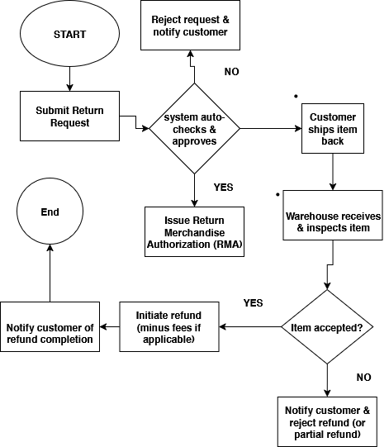
Return Flow:
1. Customer initiates return request
2. CSR reviews and approves
3. Logistics pickup scheduled
4. Item received and inspected
5. Refund processed
Refund Flow:
Triggered post item validation
Refund method: original payment, wallet credit, or bank transfer
Notification sent to customer

Slide 7
Use Case Scenarios
Happy Path:
• Full return, valid coupon, refund processed smoothly
Edge Cases:
• Partial return invalidating coupon
• Return after refund window
• Cashback reversal failure
Exception Handling:
• Damaged item disputes
• Fraudulent return attempts
• COD orders with refund to wallet

Slide 8
Coupon Handling Logic

Slide 9
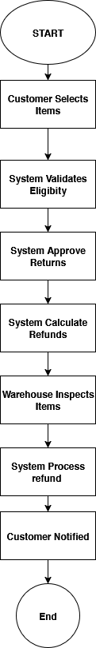
Coupon applied to order with minimum spend
Full Return: Full refund, coupon voided
Partial Return:
If minimum spend still met → partial refund
If minimum spend violated → coupon reversed, refund recalculated
Refund = (Item Price - Coupon Share)

Slide 10
Cashback Handling Logic

Slide 11
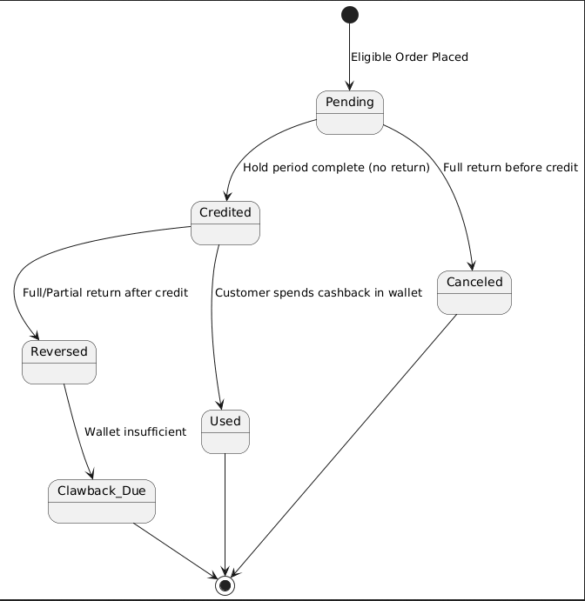
Cashback states: Pending → Credited
Full Return:
Pending cashback canceled
Credited cashback reversed
Partial Return:
Cashback recalculated based on retained items
Wallet adjustment and audit trail maintained

Slide 12
System Behavior & State Transitions

Slide 13
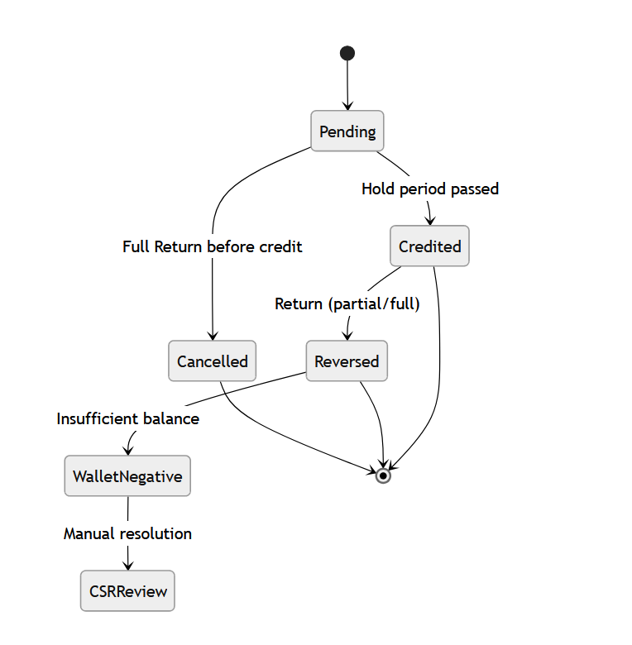
Order States: Placed → Delivered → Return Requested → Approved → Refunded
Business Rules:
Return window: 7–14 days
Refund timeline: 3–5 business days
Inventory update post-return
Fraud detection triggers

Slide 14
UML Diagrams

Slide 15
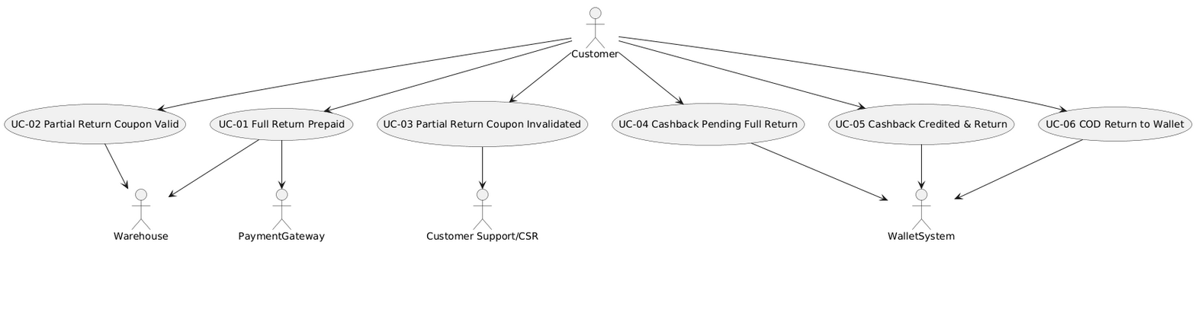
Use Case Diagram: Actors – Customer, CSR, System

Slide 16
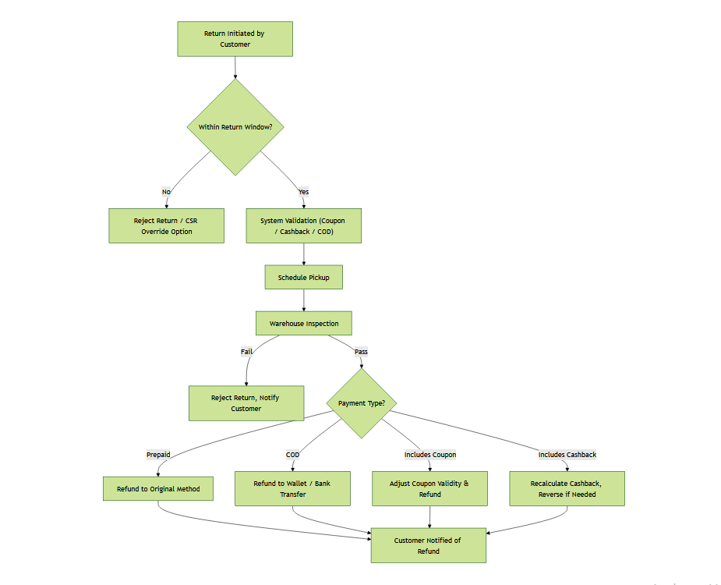
Activity Diagram: Return initiation to refund completion

Slide 17
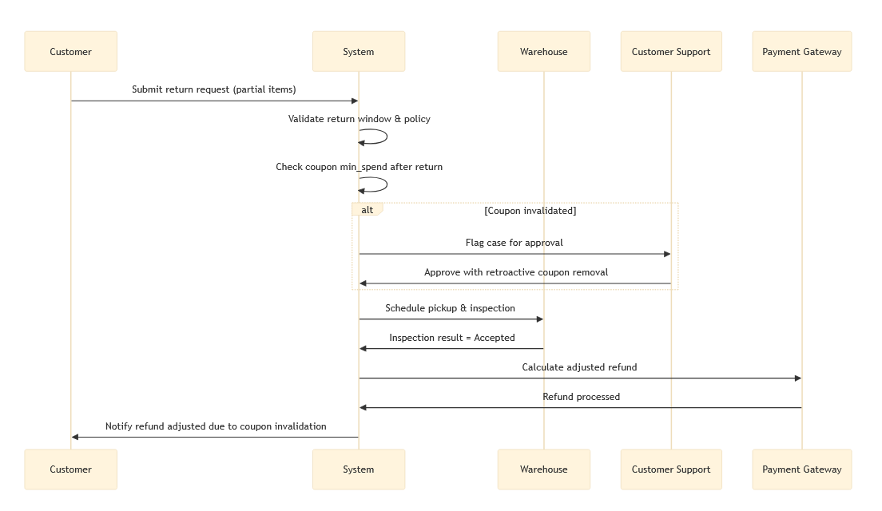
Sequence Diagram: API interactions for refund processing

Slide 18
Edge Case Handling

Slide 19
Edge Case Handling
Return after refund window → CSR override or rejection
Coupon stacking conflict → highest value retained
Cashback reversal failure → manual adjustment
Logistics failure → reschedule or escalate

Slide 20
Implementation Notes

Slide 21
Implementation Notes
Suggested Modules:
Data Entities:
KPIs:
Return Manager
Refund Engine
Coupon Validator
Cashback Tracker
Return Request
Refund Ledger
Coupon Usage
Cashback Wallet
Return Rate
Refund Accuracy
Customer Satisfaction Score

Slide 22
Conclusion & Recommendations

Slide 23
Implementation Notes
Observations:
Risks:
Recommendations:
System is scalable, modular, and developer-ready
Covers all major ecommerce scenarios
Fraud,
Logistics delays,
Refund disputes
Pilot with limited SKUs
Monitor KPIs
Integrate with CRM and accounting

Slide 24
THANK YOU
Thank you for reviewing this proposal.
Questions and feedback are welcome.
📧 Contact: official.rabbiyeasin@gmail.com
📞 Contact : +880 1953136456
🔗 LinkedIn

